Slide 1

SURYA GROUP OF INSTITUTIONS
PRATHISHRAJ G
422221104302
eBPL (Artificial Intelligence)
TEAM-10

Slide 2

Market Basket Insights
The world of retail is ever evolving, and gaining insights into customer behaviors and preferences is imperative for success. In this guide, we will explore the concept of market basket analysis, a powerful technique that allows businesses to understand the relationships between products purchased by customers. By delving into this data, businesses can uncover valuable patterns and trends, enabling them to optimize pricing strategies, improve product placement, and personalize the shopping experience. Join us on a journey to unlock the secrets hidden within your customers' baskets.

Slide 3
Understanding Market Basket Analysis
What is Market Basket Analysis?
Benefits of Market Basket Analysis
Market basket analysis is a data analysis technique used by retailers to discover associations between products frequently purchased together by customers. By examining transactional data, such as customer receipts, this method allows businesses to uncover hidden patterns and relationships. These insights can be leveraged to make informed decisions and enhance overall business performance.
Market basket analysis offers numerous benefits to businesses. It enables retailers to identify cross-selling and upselling opportunities, optimize product promotions, and enhance customer segmentation. By understanding which items are frequently purchased together, retailers can tailor their marketing efforts, create targeted campaigns, and improve the overall customer experience.

Slide 4
Implementing Market Basket Analysis
1
Data Collection
The first step in implementing market basket analysis is to collect relevant transactional data. This includes customer purchase history, comprising the products they bought and the associated quantities.
Data Preparation
2
Once data is collected, it needs to be cleaned and preprocessed. This involves removing errors and inconsistencies and transforming the data into a suitable format for analysis.
3
Association Rule Mining
The heart of market basket analysis lies in association rule mining. This process involves discovering patterns or rules that suggest relationships between products. This information can guide decision-making and drive strategic business actions.

Slide 5
The Power of Association Rules
Support
Confidence
Lift
Support is a measure of how frequently a particular combination of products appears in the dataset. It helps identify the most common product associations and guides decision-making related to product placement and cross-selling opportunities.
Confidence measures the likelihood of a product being purchased when another product is bought. Higher confidence values indicate stronger associations between products, helping retailers optimize marketing strategies and personalize recommendations.
Lift is a measure of how much more likely it is for two products to be purchased together compared to their individual likelihoods. Lift values greater than 1 indicate positive associations, while values less than 1 suggest negative associations.

Slide 6
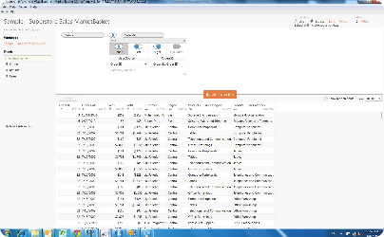
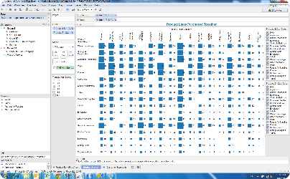
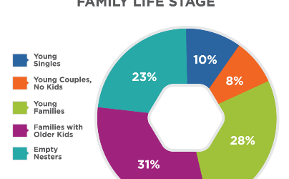
Visualizing Market Basket Insights
Data Visualization
Optimization Strategies
Customer Segmentation
Data visualization is key in extracting meaningful insights from market basket analysis results. Through visually appealing charts and graphs, businesses can easily identify top-selling product combinations and effectively communicate these insights to stakeholders.
Market basket analysis can help retailers optimize product pricing, promotions, and store layouts. Visualizing the impact of different strategies can provide a clear understanding of potential opportunities, enabling businesses to make data-driven decisions and stay ahead of the competition.
By analyzing market basket data, retailers can segment customers based on their shopping preferences and behaviors. Visualizing these segments can aid in creating targeted marketing campaigns, improving customer retention, and personalizing the shopping experience.

Slide 7
Market Basket Insights in Action
Supermarket Chain
Online Retailer
A large supermarket chain utilized market basket analysis to identify commonly purchased items during specific seasons. The insights obtained allowed the retailer to optimize product placements, create attractive product bundles, and enhance in-store promotions, resulting in increased sales and customer satisfaction.
An online retailer leveraged market basket analysis to personalize product recommendations. By understanding the associations between products, the retailer was able to create personalized suggestions that enhanced the customer shopping experience, leading to improved customer engagement, loyalty, and overall revenue.

Slide 8

Conclusion
Market basket analysis is a powerful tool that can unlock valuable insights hidden within customer purchase data. By understanding the associations between products, businesses can optimize pricing, improve product placement, and provide personalized recommendations to enhance the overall shopping experience. Embrace the power of market basket analysis and embark on a journey of data-driven success.

